Slide 1

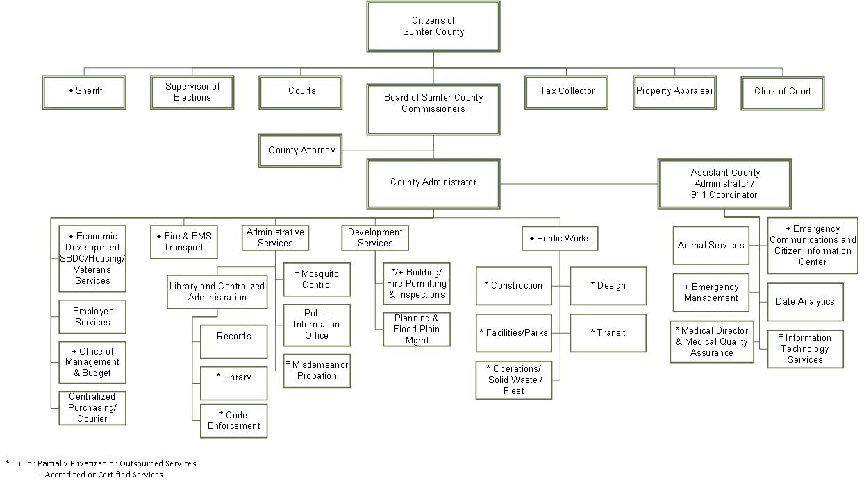
Sumter County Government

Slide 2
General Fund Revenue
The FY 23/24 Budget is comprised of the General Fund, Special Revenue Funds, Debt Service Funds, and an Internal Service Fund
The General Fund’s largest revenue source is the Ad Valorem (Property) Tax
Other major sources of revenue include the countywide non-Ad Valorem fire assessment, small county sales tax, intergovernmental transfers and charges for services
The rolled-back rate is 5.1974 for the tax year of 2023 (FY 23/24)
The BOCC directed proposed millage rate to be 5.1900 which is a 7.16% reduction from the FY22/23 millage rate
The millage rate of 5.19 is the lowest millage rate directed by the Board in Sumter County

Slide 3
Sumter County Millage Rate History with Proposed FY 23/24 Levy Included
5

Slide 4
Proposed General Fund Revenue (Including Reserves and Transfers)

Slide 5
Proposed General Fund Expenditures (excluding Reserves and Transfers)

Slide 6
General Fund Revenue
The countywide non-Ad Valorem Fire Assessment is proposed to increase for residential properties from $124.00 per year to $323.64 per year
The additional change in the methodology is a per square foot charge for commercial, industrial, and institutional properties

Slide 7
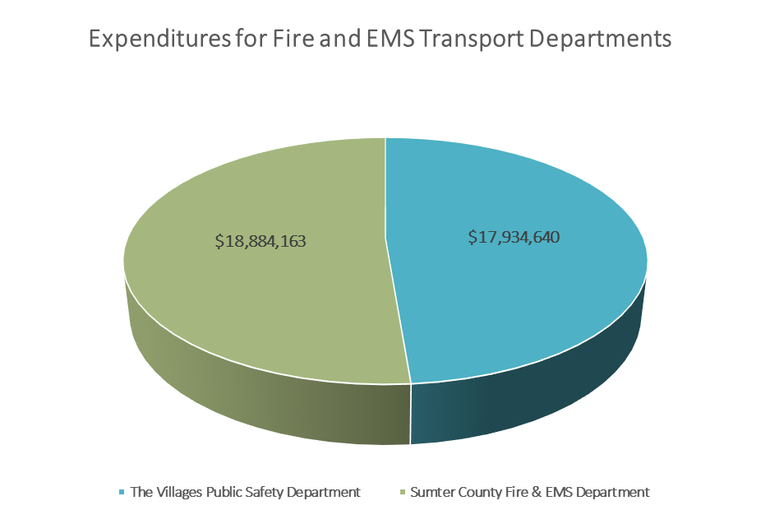
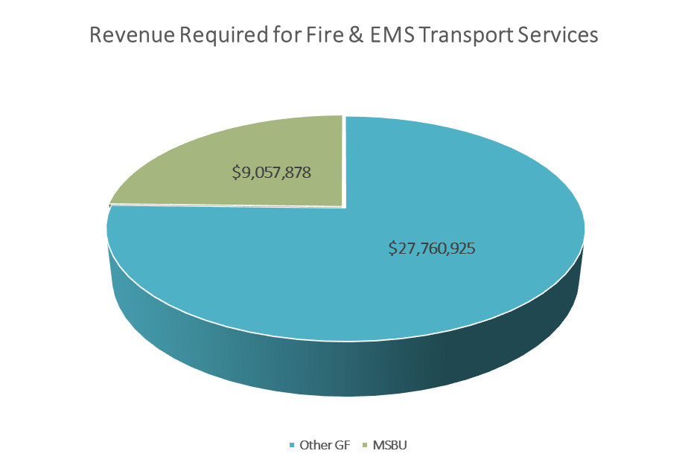
Sumter County Fire & EMS Transport Departments FY 22/23
Total $36,818,803
Total $36,818,803

Slide 8
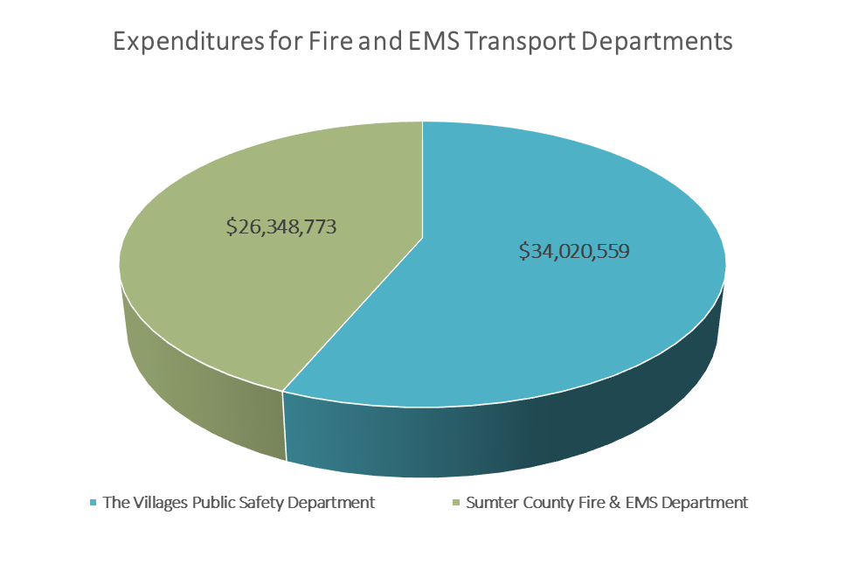
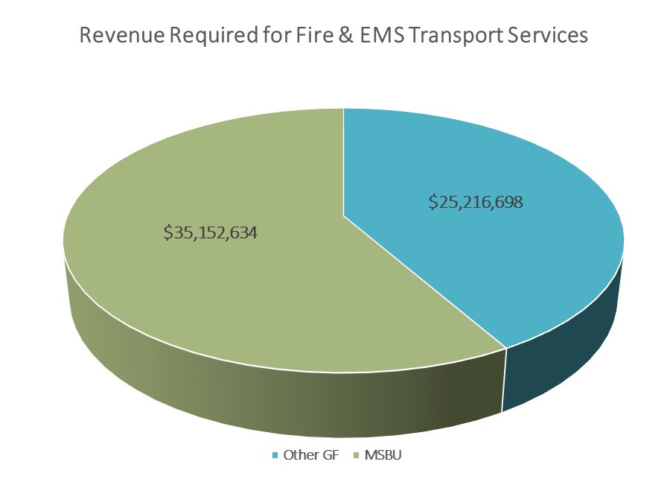
Sumter County Fire & EMS Transport Departments FY 23/24
Total $60,369,332
Total $60,369,332
Change from FY 22/23 to FY23/24 = $23,550,529

Slide 9
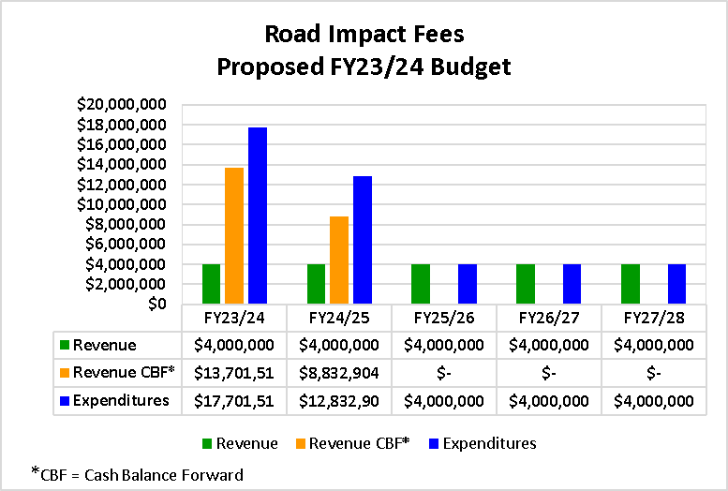
Road Impact Fees
An Impact fee is a one-time capital charge levied against new development and designed to cover the portion of the capital costs and infrastructure capacity consumed by new development.

Slide 10
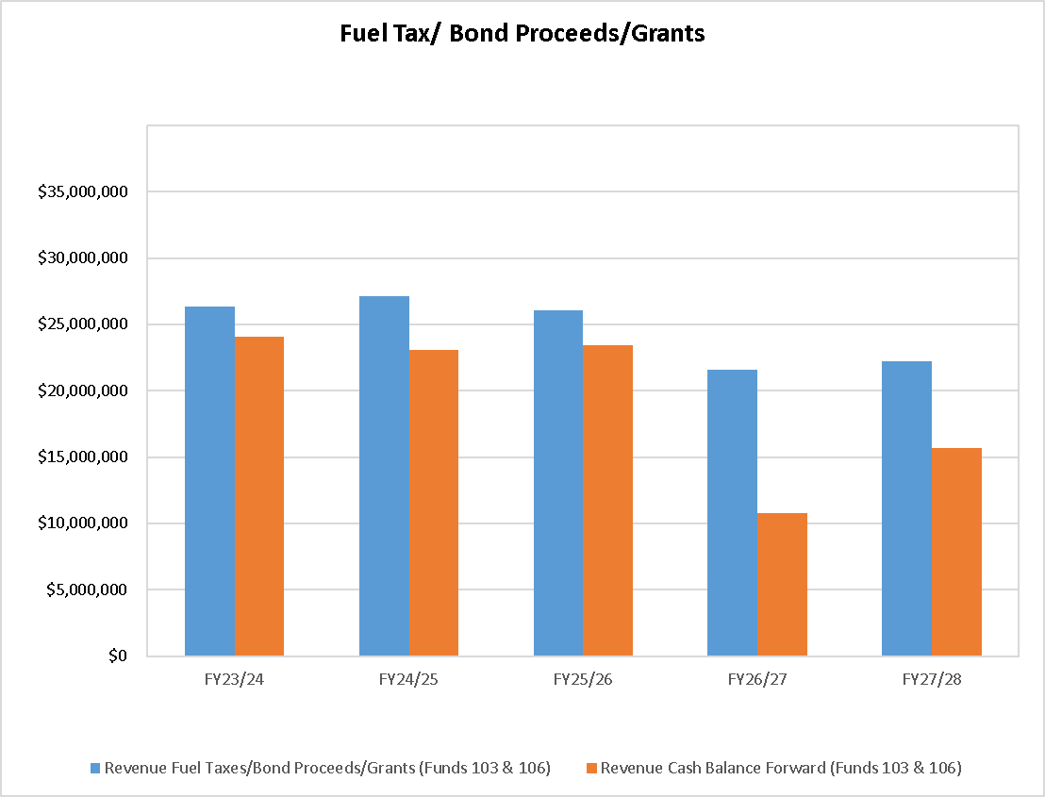
Fuel Tax
For purposes of fuel tax administration, fuel is defined as motor, diesel, aviation or natural gas fuel.

Slide 11
Building Construction Projects

Slide 12

References and Thank You!
Proposed FY 23/24 Documents
https://www.sumtercountyfl.gov/AgendaCenter/ViewFile/Agenda/_07112023-780?html=true
Preliminary Non-Ad Valorem Fire Assessment Rate Resolution
https://www.sumtercountyfl.gov/AgendaCenter/ViewFile/Agenda/_07112023-800?html=true
County Administrator
Bradley.Arnold@sumtercountyfl.gov
Chairman Craig Estep
Craig.Estep@sumtercountyfl.gov
Vice Chairman Roberta Ulrich
Roberta.Ulrich@sumtercountyfl.gov
Second Vice Chairman Jeffrey Bogue
Jeff.Bogue@sumtercountyfl.gov
Commissioner Andrew Bilardello
Andy.Bilardello@sumtercountyfl.gov
Commissioner Don Wiley
Don.Wiley@sumtercountyfl.gov

